Slide 1


UniMingle
- The exclusive cultural exchange platform for UOA students
Presented by MCI Project Team 15
Xuankai Feng a1700592
Junhong Zhu a1712762
Xiuquan Wang a1693663

Slide 2
1
Marketing Research
2
Solution-UniMingle
3
Platform Design
4
Project schedule
5
Reference

Slide 3
1
Marketing Research
To get to know what our potential users need

Slide 4

Isolated
Nervous
Anxious
Confused
Lonely
Passive
A great number of international students are facing cultural challenges and they find hard to merge into the local society. (Mori, 2000)
Helpless

Slide 5

The connection and interaction among peers should be convenient
Students do need a platform to help promote cultural exchange
The platform should be reliable and diversified

Slide 6
Survey Goals
The marketing survey aims at testing the predilection of potential users about UniMingle from the following 5 aspects:
2. Demand on platforms help cultural exchange
4. Personal preferential
activities
1. Experiences about getting on with local students
3. Concern about being participate in offline activities
5. Excepted functional modules of UniMingle

Slide 7
Survey Content
Previous
Experiences
Functional
Modules
Aspiration
STEP 01
STEP 02
STEP 03
Invite participates to share their previous experiences of going out with foreigners.
Get to know the aspiration of students which refers to their expected functions and interested activities.
Inquiry students' views towards proposing functional modules as well as their preferences on selecting activities.

Slide 8
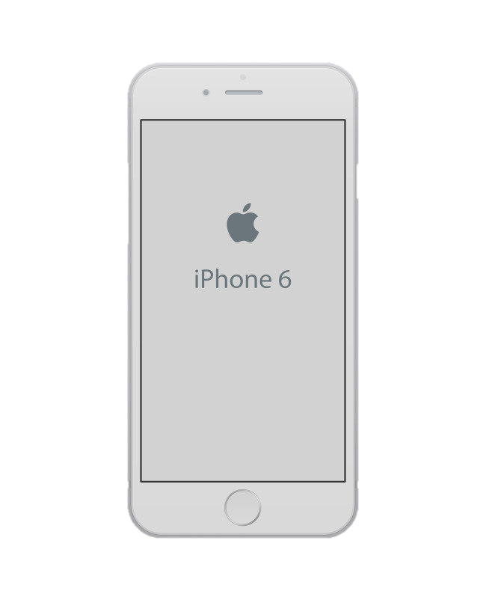
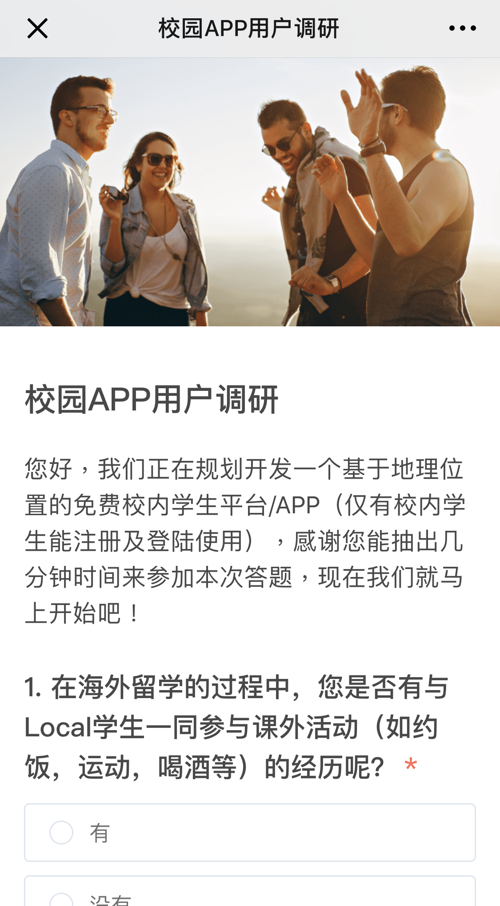
Survey Result
Campus platform survey
Totally 31 survey samples are collected
61.29% of participants had the experience of going out with local students
Campus platform survey
75% of participants find hard to blend into local culture
Hi, we are going to develop a students activity platform which is based on GPS. This platform is for UOA students only. Thanks for helping finish this survey and let’s start now!
80.65% of participants are interested in an APP that can help provoke cultural exchange
1. During you experiences of studying abroad, had you taken part in any activities with local students? (e.g. sports, beers)
Yes
No

Slide 9
2
Solution
Unimingle
The general introduction of UniMingle

Slide 10


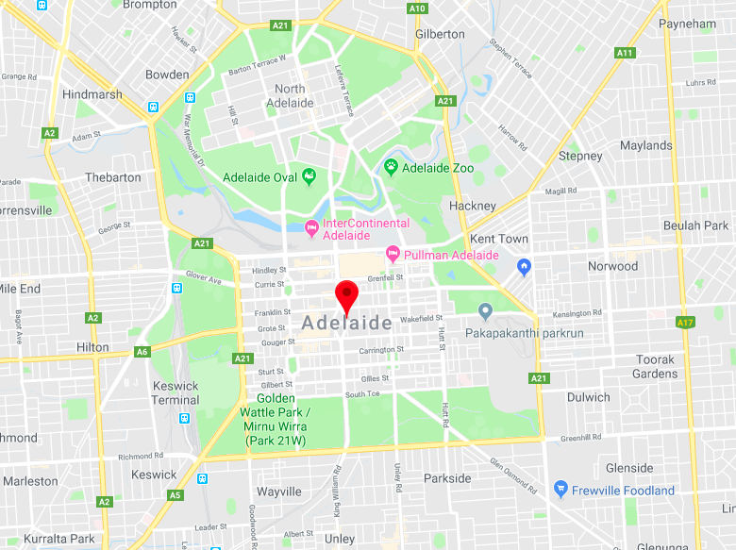

UniMingle Introduction
A meet up platform based on geographic position, UOA students exclusively.
1.UOA Students Exclusively
UniMingle is a UOA students exclusively platform though university mail verification, in order to ensure the safety.
Image
Image
2.Various Activities Recruitment
There will be different activities provided to UOA students including beer and skittles.
Image
Image
3. Real-time Heating Map
To take advantage of GPS service, UniMingle will show current activities with real-time participation and heat.
4.Create your own activities
Users can create their own activities on UniMingle, others can see and join after auditing.

Slide 11
3
Platform
Design
A general demonstration of technology structure and UI design of UniMingle

Slide 12
Web Clients
Windows
Mac
Linux
Android
iOS
More….
Business Services
User Service
Event Service
Common Service
Login
Register
Create
Read
API Control
Data Source
Logout
OAuth
Update
Delete
Config Setting
Log Handler
Role
Access
Search
Location
Cache Manage
Metadata
Data Storage
In-memory DB
RDBMS
File Storage
synchronization

Slide 13
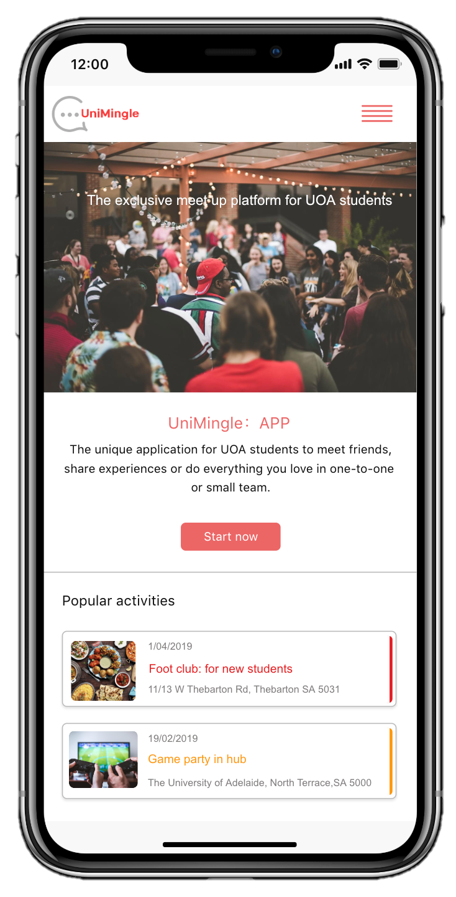
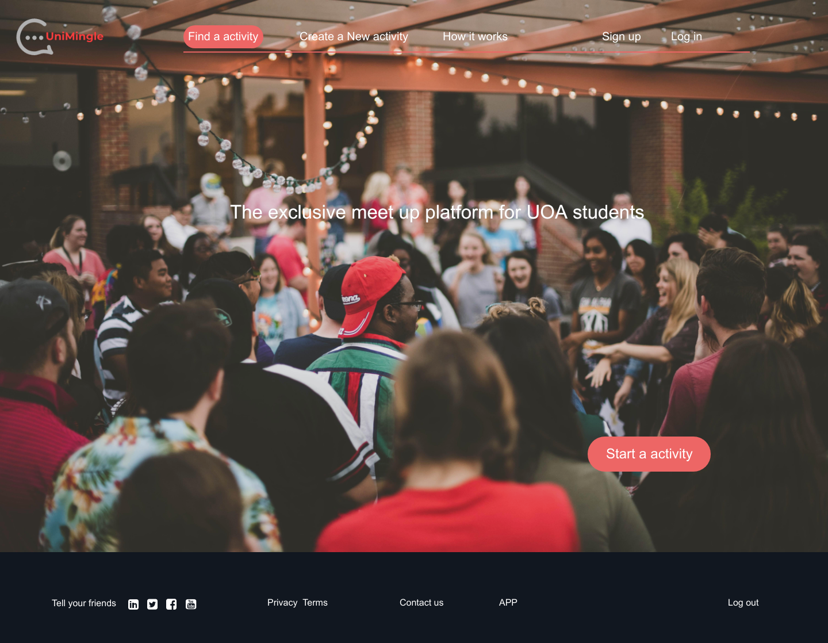
Homepage
Desktop Homepage
Mobile Homepage

Slide 14
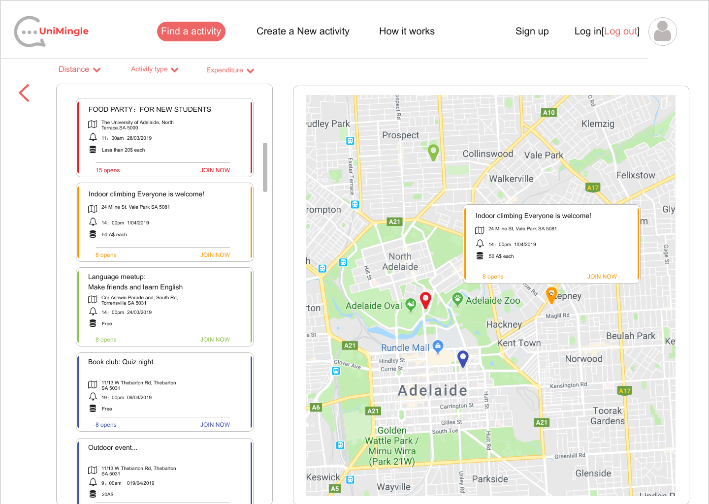
Heating Map
In this page, all activities on UniMingle will be presented as a list as well as indicated on the map. The most popular activities will be labels as “heat activity” in obvious color.
And activities of different popularity degree will have different colors.

Slide 15
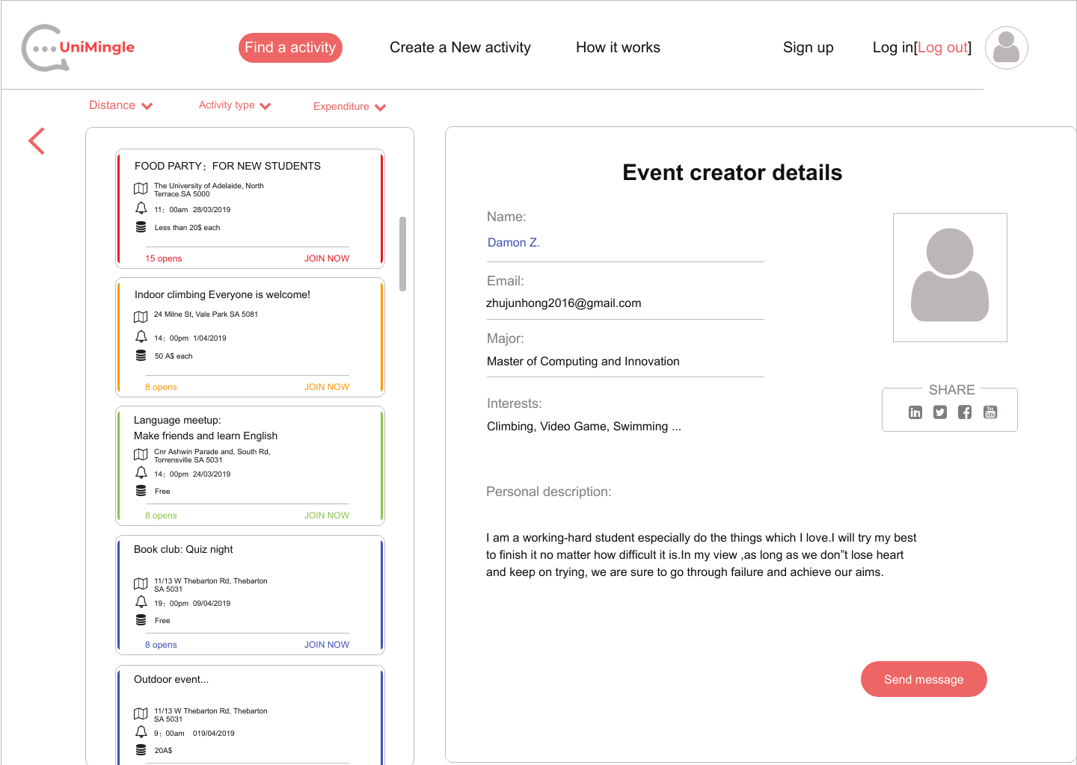
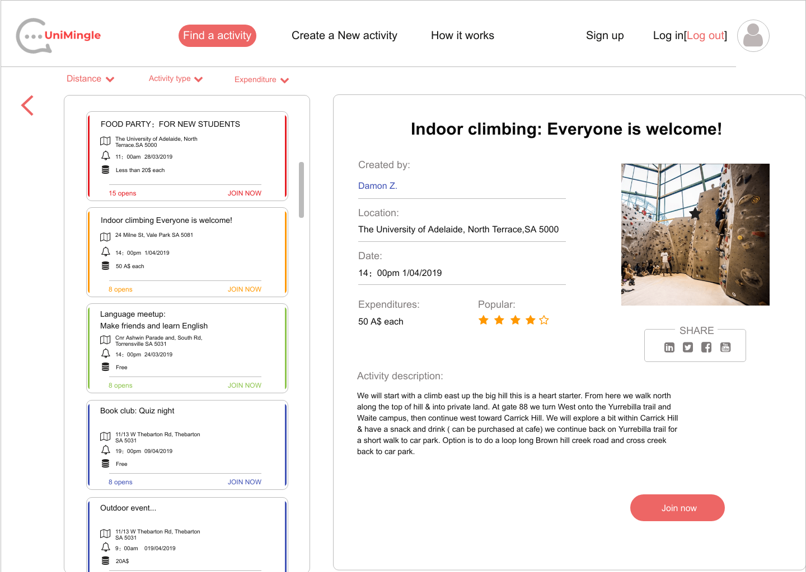
Activity Module
Details of each activity will be shown clearly and users could apply for creating their own activities conveniently.

Slide 16
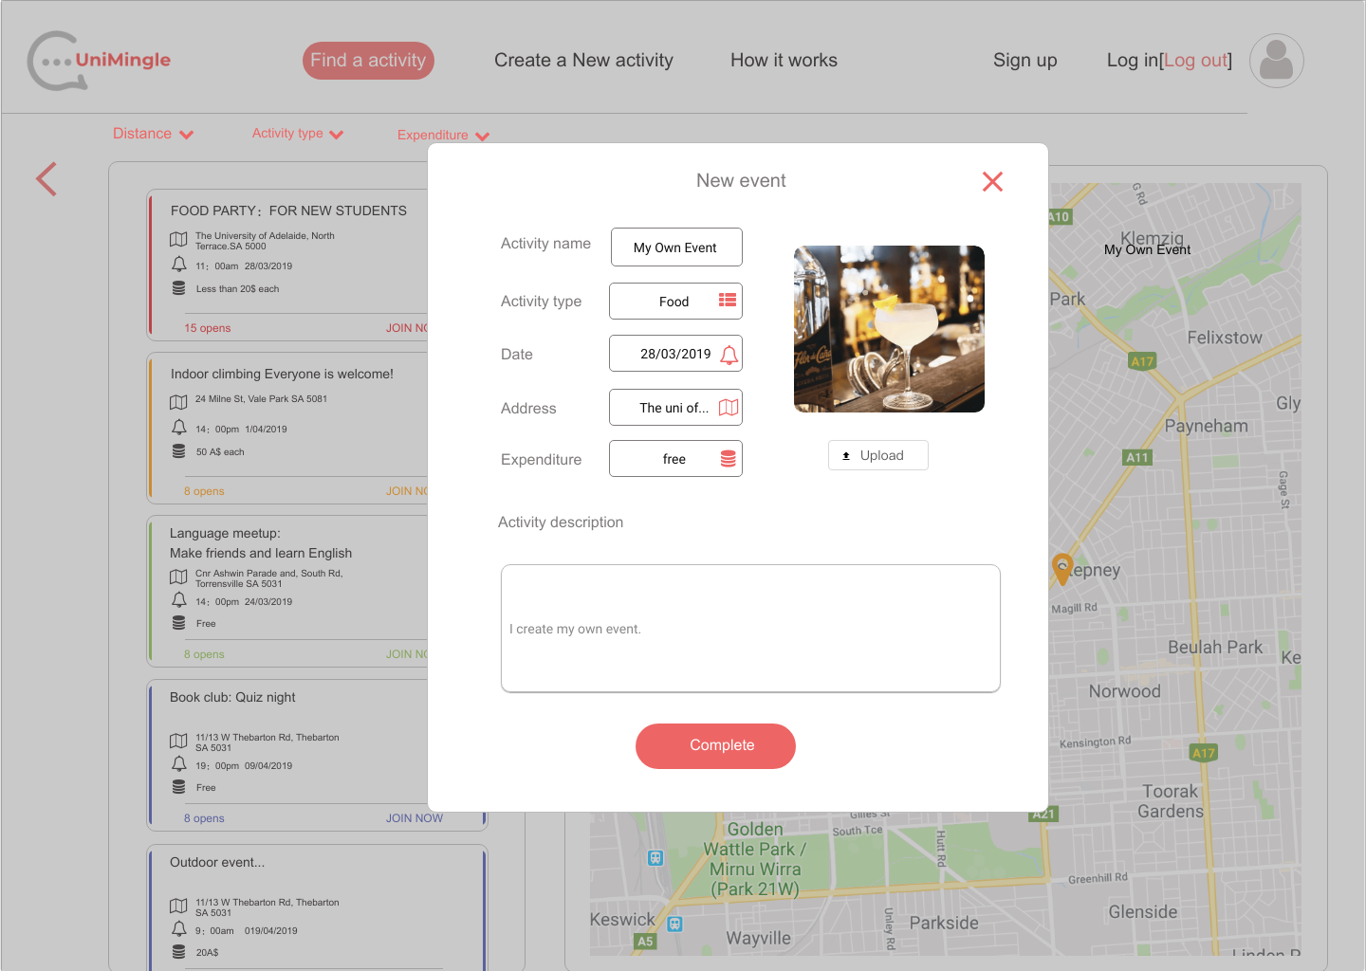
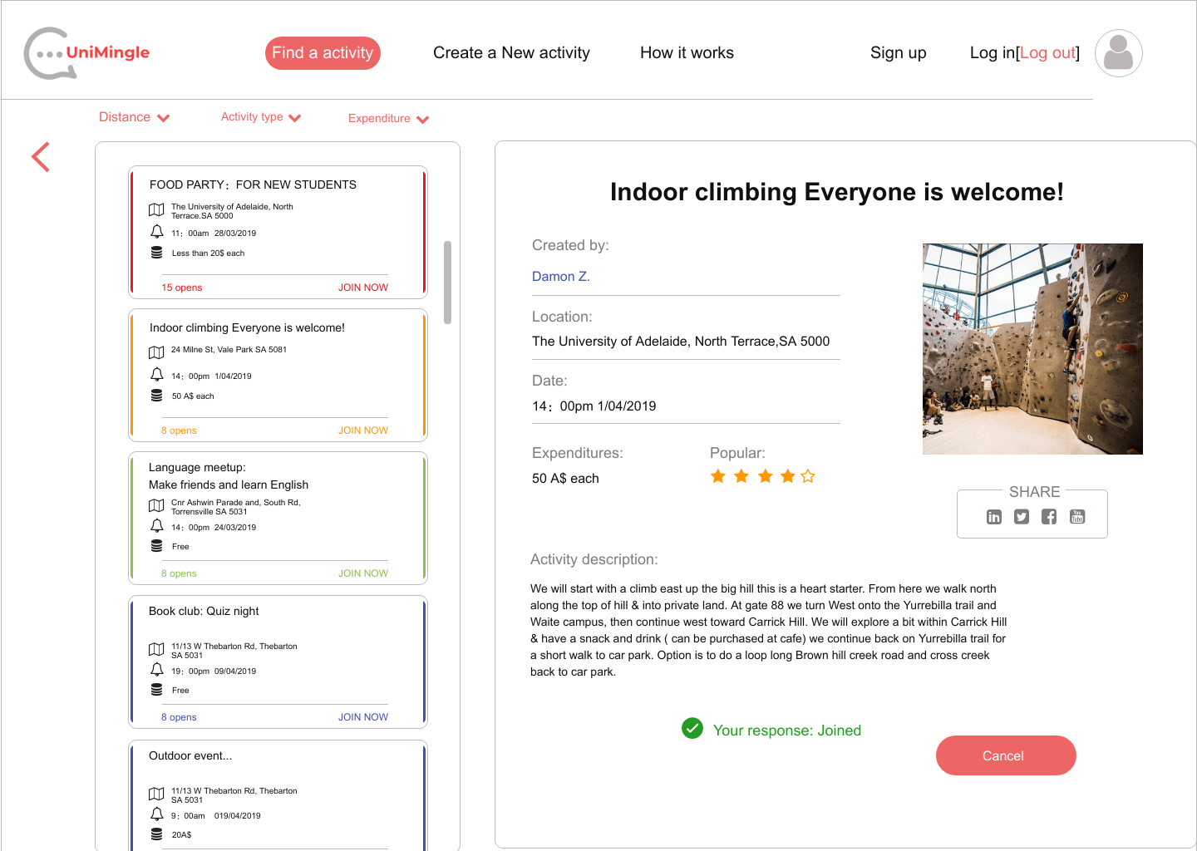
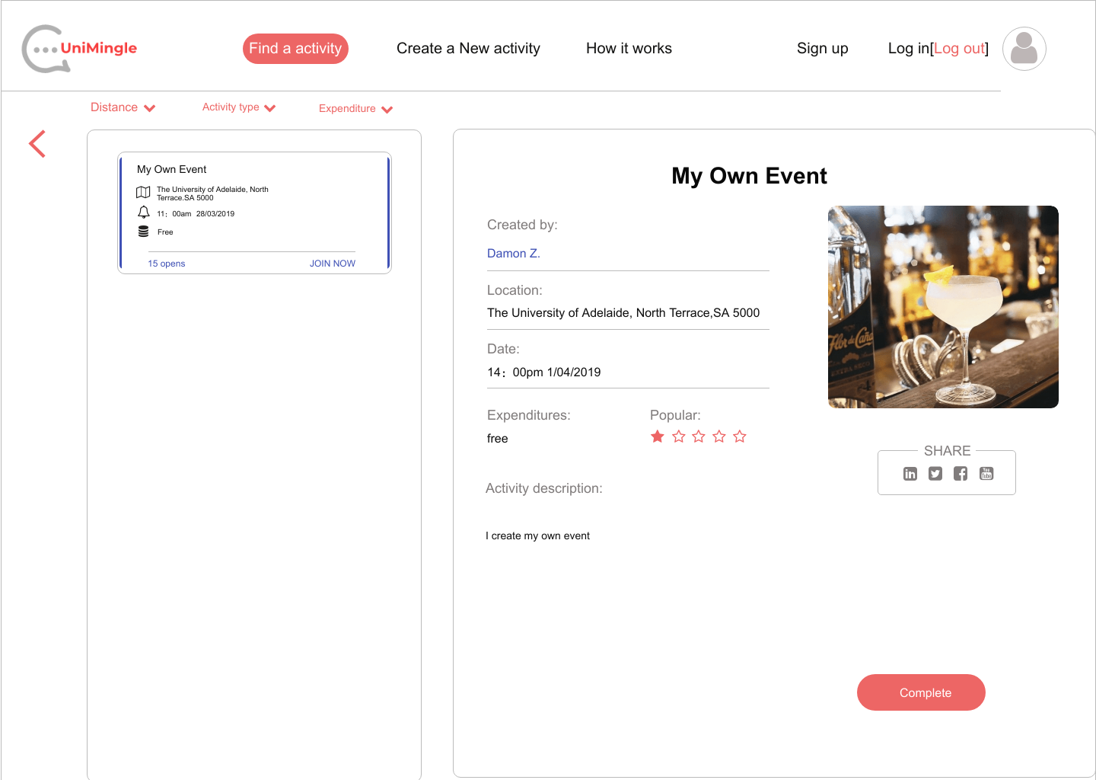
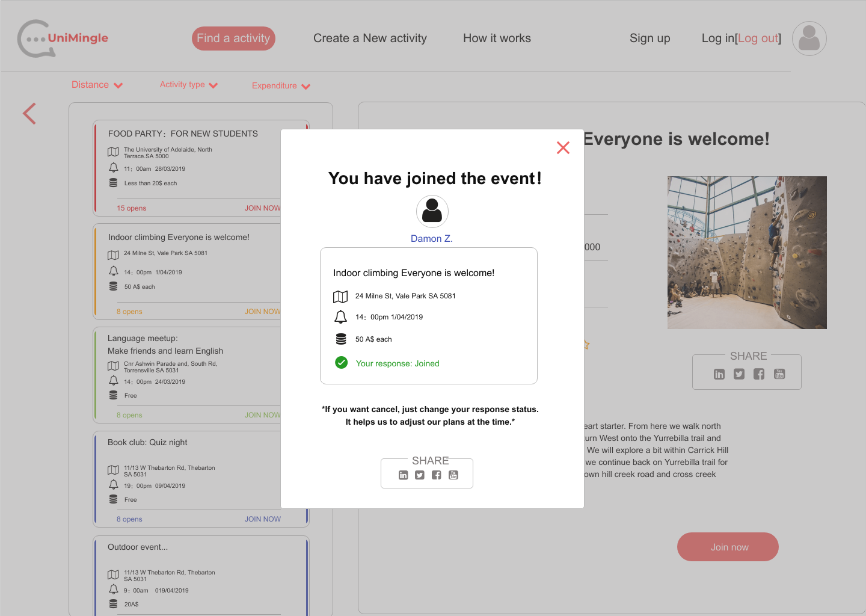
Activity Module
Sample of creating your own activity
Sample of taking part in an existing activity

Slide 17
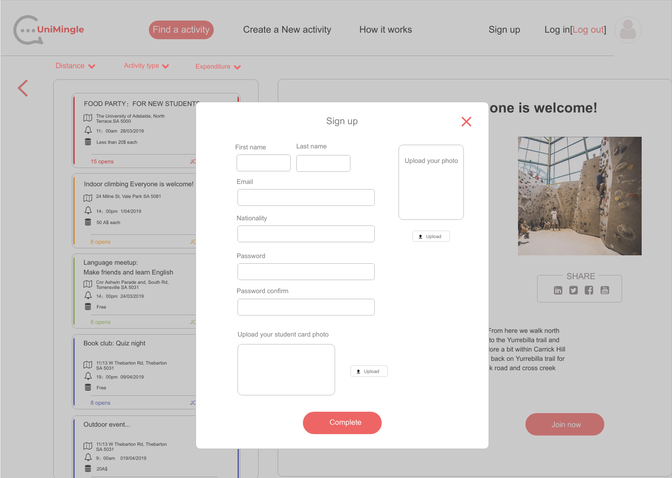
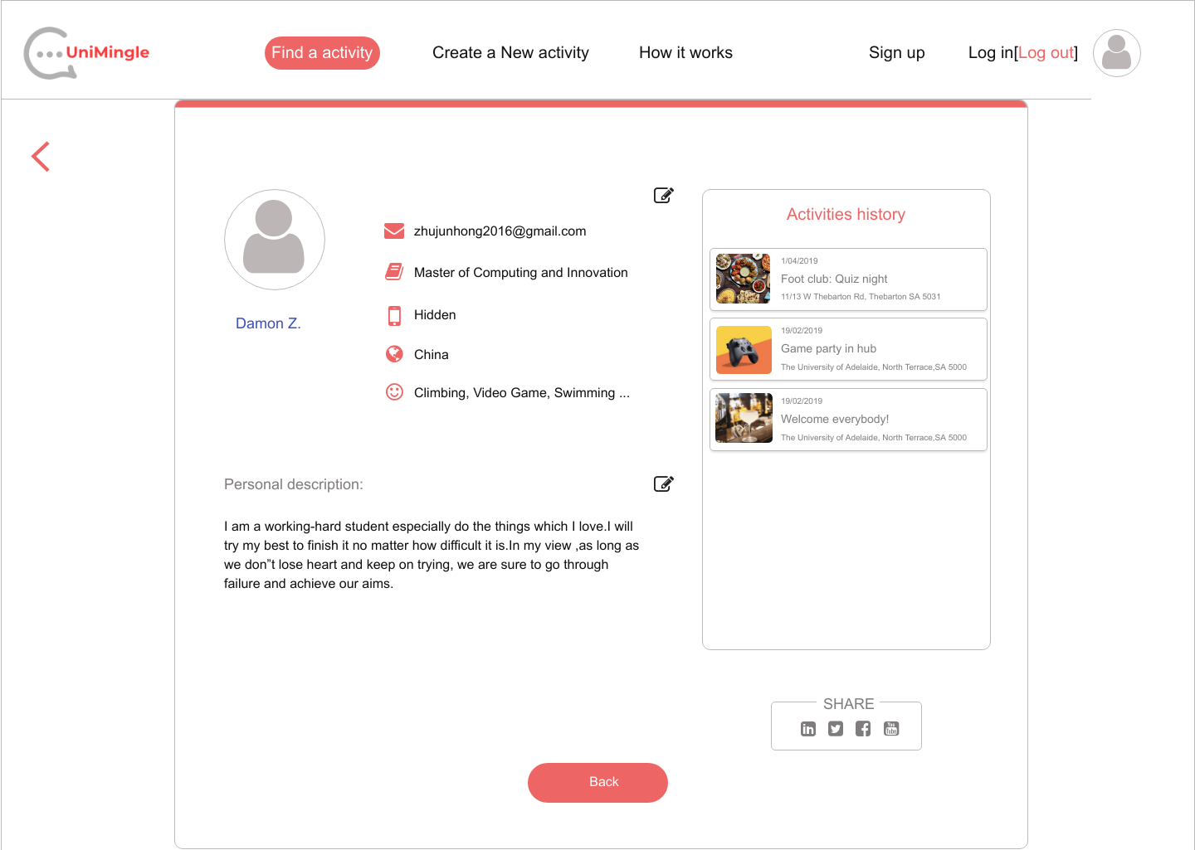
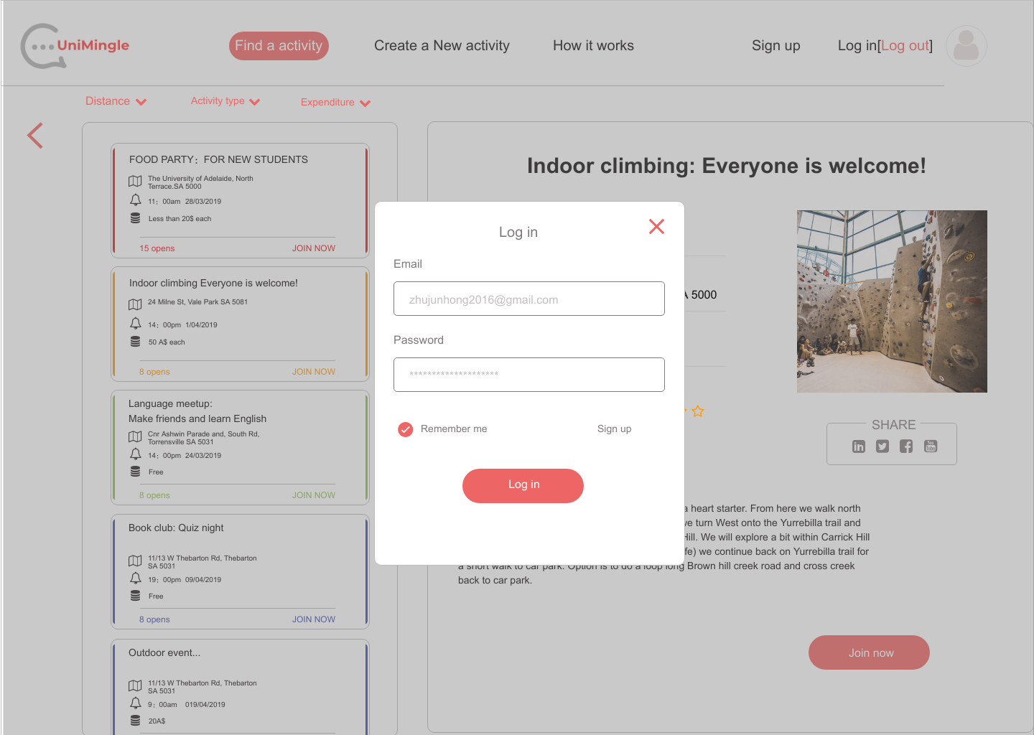
User Module
User module schematic diagrams including register, log in and personal info pages.
https://org.modao.cc/app/design/p9BA06CE76E1552916493716

Slide 18
4
Project Schedule
A timetable of UniMingle which shows the milestones as well

Slide 19
Project Schedule
Milestone #3
Milestone #4

Slide 20
Project Milestones
Milestone1
By the end of week6
Milestone2
By the end of week8
Milestone3
By the end of week10
Milestone4
By the end of week11/12
Front-end overall layout design
User login/register
Back-end overall design
Common modules implementations
User API implementation
Events create/read /update /delete
Events category maintain
Event GEO map design
GEO map implementation
Functions/Performance Test
Deploy release online
Documents prepare
Presentation prepare

Slide 21
5
Reference
Academic materials and other sources that help support this presentation

Slide 22
Reference
Mark Otto, a. (2019). Bootstrap. [online] Getbootstrap.com. Available at: https://getbootstrap.com/ [Accessed 21 Mar. 2019].
Mori, S. (2000). Addressing the Mental Health Concerns of International Students. Journal of Counseling & Development, 78(2), pp.137-144.
Otwell, T. (2019). Laravel - The PHP Framework For Web Artisans. [online] Laravel.com. Available at: https://laravel.com/ [Accessed 21 Mar. 2019].
Reactjs.org. (2019). React – A JavaScript library for building user interfaces. [online] Available at: https://reactjs.org/ [Accessed 21 Mar. 2019].

Slide 23
Thanks
Presented by MCI Project Team 15
Xuankai Feng a1700592
Junhong Zhu a1712762
Xiuquan Wang a1693663

